Slide 1
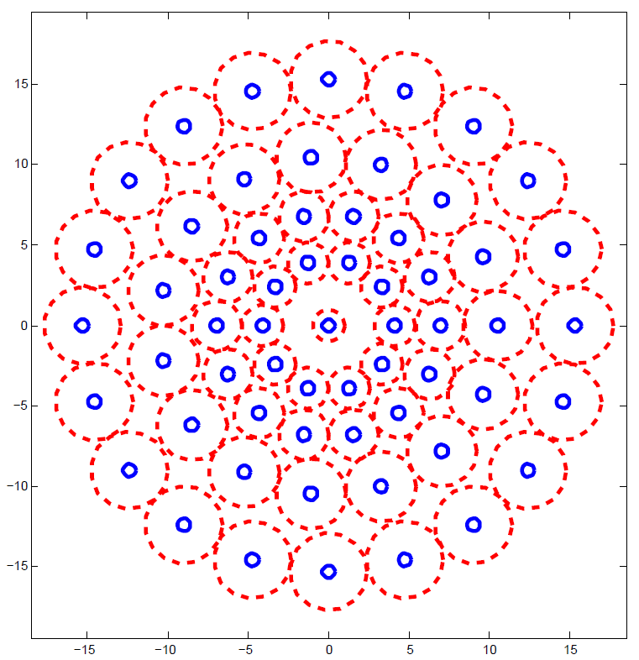
BRISK (Presented by Josh Gleason)
Binary Robust Invariant Scalable Keypoints
Sefan Leutenegger, Margarita Chli and Roland Y. Siegwart
ICCV11

Slide 2
Overview
Objective
Related Work
Key-point detection
Key-point description
Key-point matching
Experiments and Results
Examples

Slide 3
Objective
Detect features which, when compared to state-of-the-art methods
Perform similarly.
Are dramatically more computationally efficient.

Slide 4
Related Work
FAST
AGAST
BREAF
DAISY
FREAK
SURF
SIFT

Slide 5
Keypoint detection steps
Create scale space
Compute FAST score across scale space.
Pixel level non-maximal suppression.
Compute sub-pixel maximum across patch.
Compute continuous maximum across scales.
Re-interpolate image coordinates from scale space feature point detection.

Slide 6
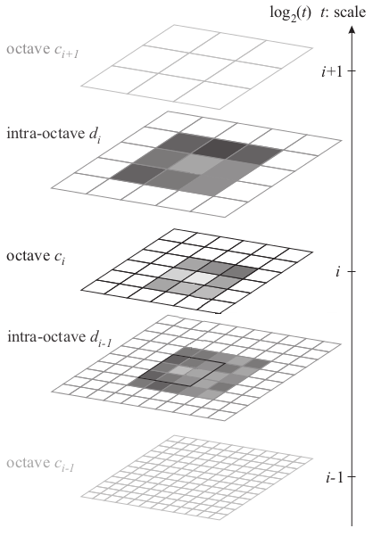
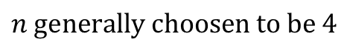
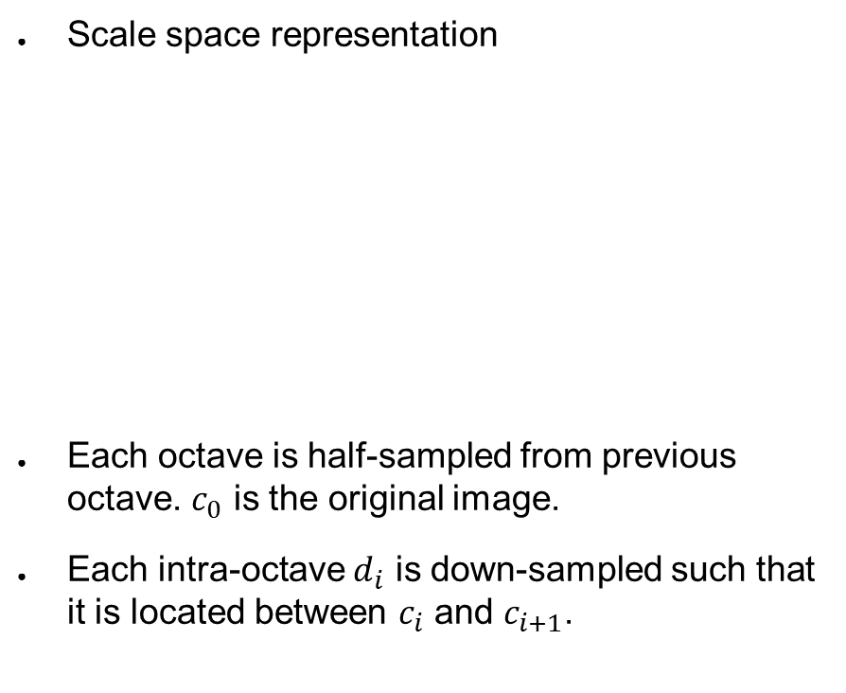
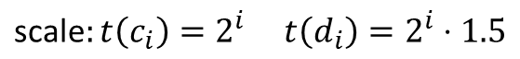
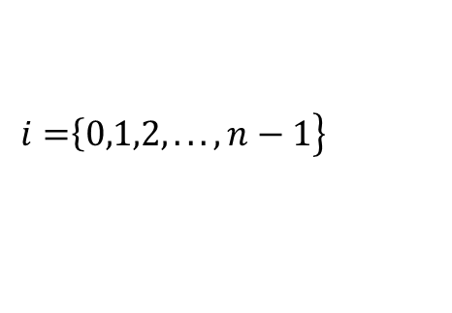
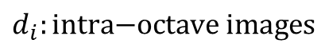
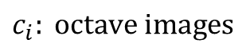
Create scale space
Scale space representation
Each octave is half-sampled from previous octave. $c_{0}$ is the original image.
Each intra-octave $d_{i}$ is down-sampled such that it is located between $c_{i}$ and $c_{i+1}$.
$$c_{i}: \text{o}\text{ctave} \text{images}$$
$$d_{i}:\text{intra}\text{−}\text{octave} \text{images}$$
$$\left.\left.i=\right\{0,1,2,...,n−1\right\}$$
$$\text{scale}:t\left(c_{i}\right)=2^{i} t\left(d_{i}\right)=2^{i}⋅1.5$$
$$n \text{generally} \text{choosen} \text{to} \text{be} 4$$

Slide 7
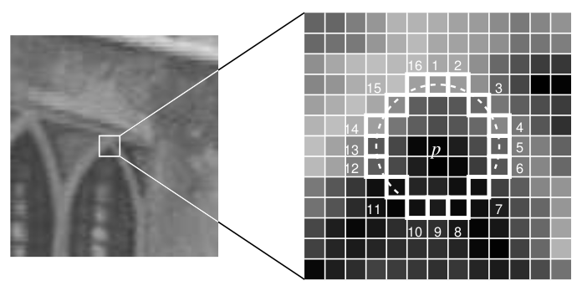
FAST Score
Computed at each octave and intra-octave separately.
Use the FAST detector score s.
s is defined for each pixel as the maximum threshold for FAST detection which still considers an image point a corner.
The 16 point FAST detector is used which requires 9 consecutive pixels which are sufficiently brighter or darker than the central pixel.

Slide 8
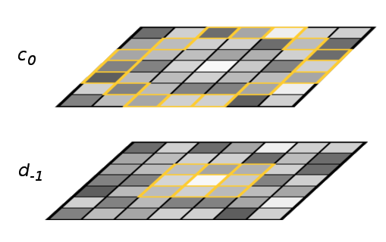
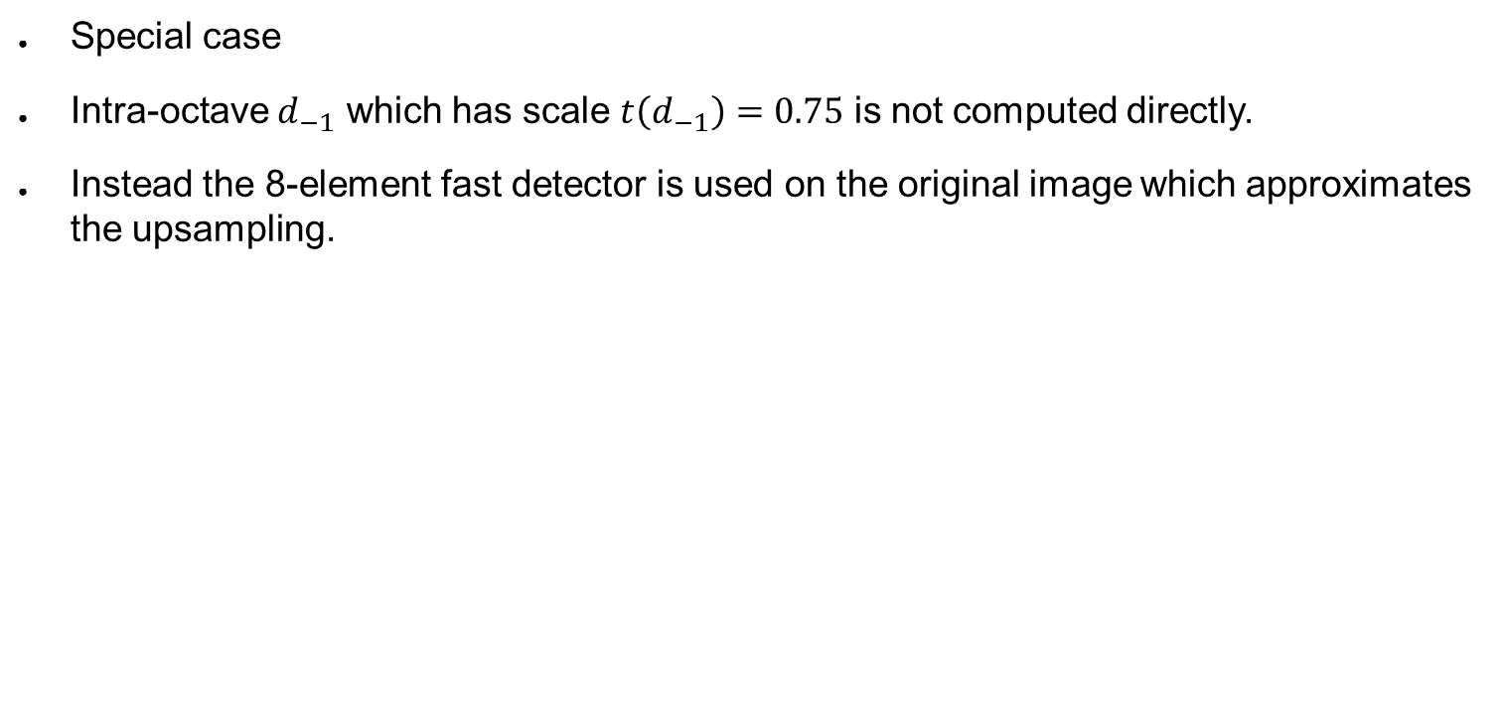
Keypoint detection
Special case
Intra-octave $d_{−1}$ which has scale $t\left(d_{−1}\right)=0.75$ is not computed directly.
Instead the 8-element fast detector is used on the original image which approximates the upsampling.
Notes:
Important to improve speed and memory

Slide 9
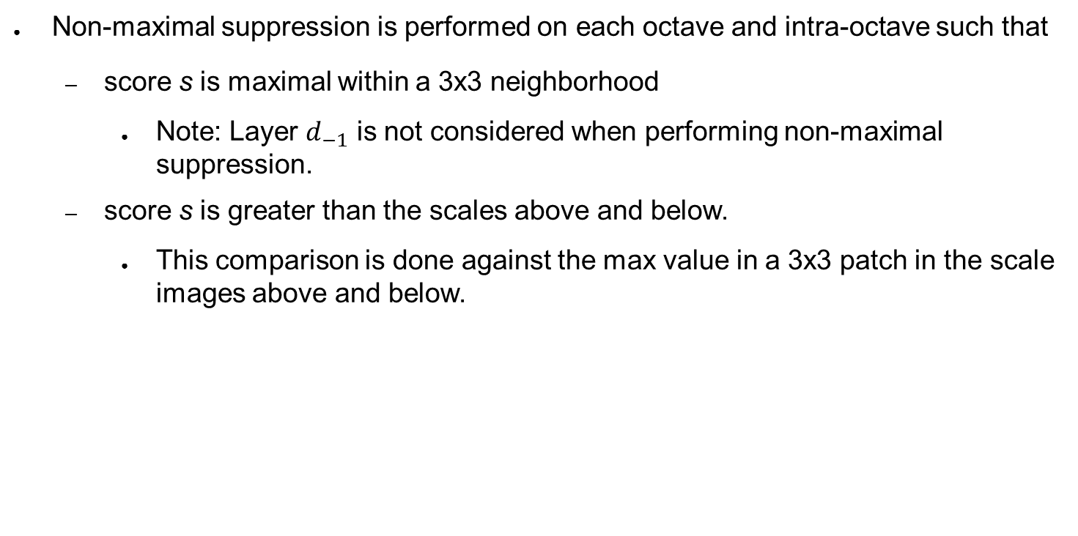
Non-maximal suppression
Non-maximal suppression is performed on each octave and intra-octave such that
score s is maximal within a 3x3 neighborhood
Note: Layer $d_{−1}$ is not considered when performing non-maximal suppression.
score s is greater than the scales above and below.
This comparison is done against the max value in a 3x3 patch in the scale images above and below.

Slide 10
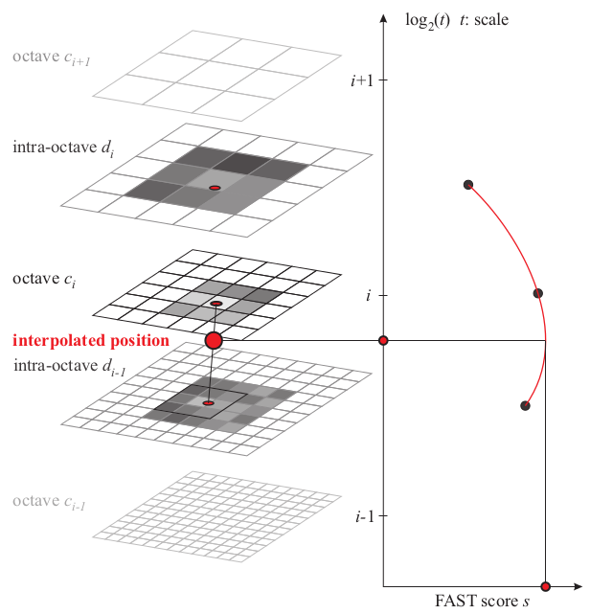
Subpixel maxima and scale selection
Using points obtained using non-maximal suppression.
2D quadratic function is fit to the 3x3 patch surrounding the pixel and sub-pixel maximum is determined.
The same is done for the layer above and below.
These maxima are then interpolated using a 1D quadratic function across scale space and the local maximum is chosen as the scale for the feature is found.
Selected scale

Slide 11
Keypoint Description
Sample pattern of smoothed pixels around feature.
Separate pairs of pixels into two subsets, short-distance pairs and long-distance pairs.
Compute local gradient between long-distance pairs.
Sum gradients to determine feature orientation.
Rotate short-distance pairs using orientation.
Construct binary descriptor from rotated short-distance pairs.

Slide 12
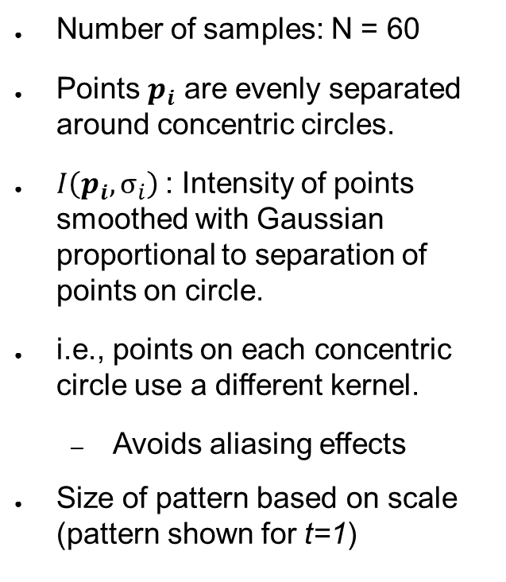
Sampling pattern
Number of samples: N = 60
Points $p_{i}$ are evenly separated around concentric circles.
$I\left(p_{i},σ_{i}\right)$: Intensity of points smoothed with Gaussian proportional to separation of points on circle.
i.e., points on each concentric circle use a different kernel.
Avoids aliasing effects
Size of pattern based on scale (pattern shown for t=1)

Slide 13
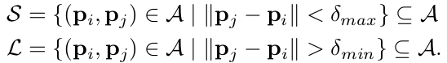
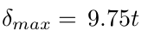
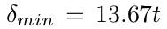
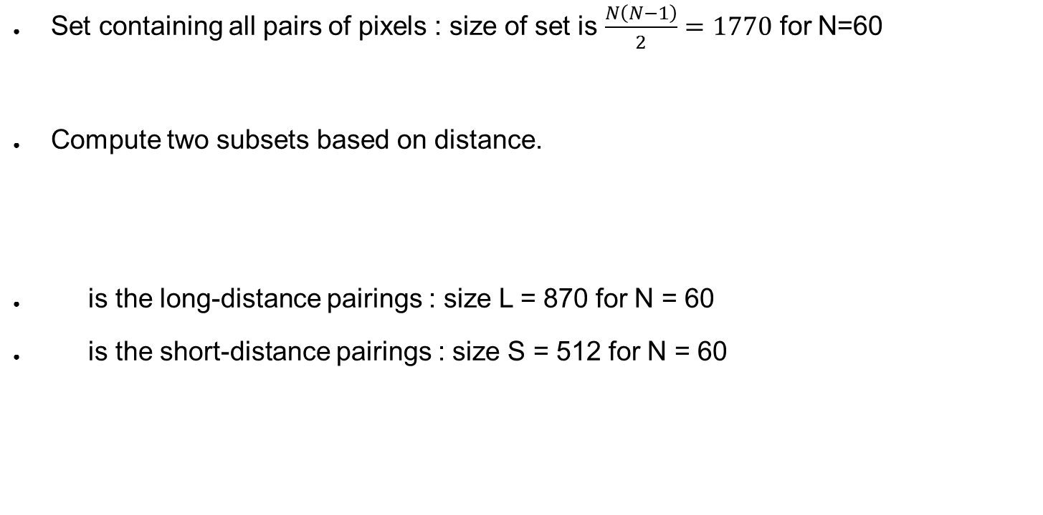
Pattern pairs
Set containing all pairs of pixels : size of set is $\frac{N\left(N−1\right)}{2}=1770$ for N=60
Compute two subsets based on distance.
is the long-distance pairings : size L = 870 for N = 60
is the short-distance pairings : size S = 512 for N = 60

Slide 14
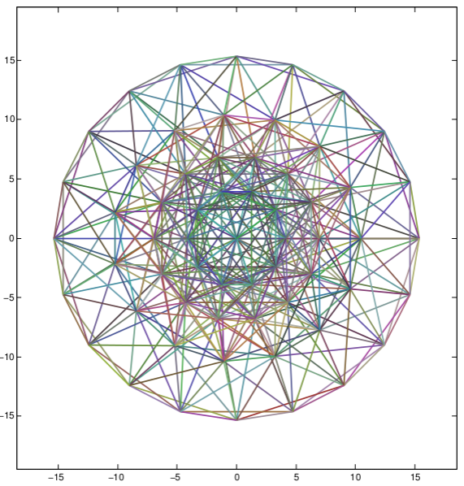
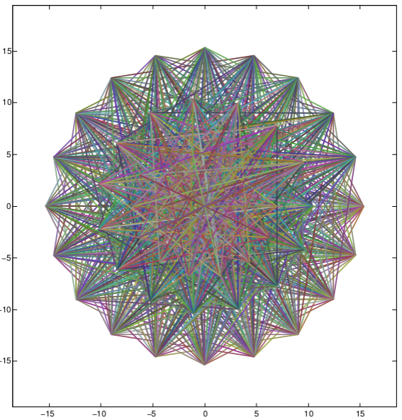
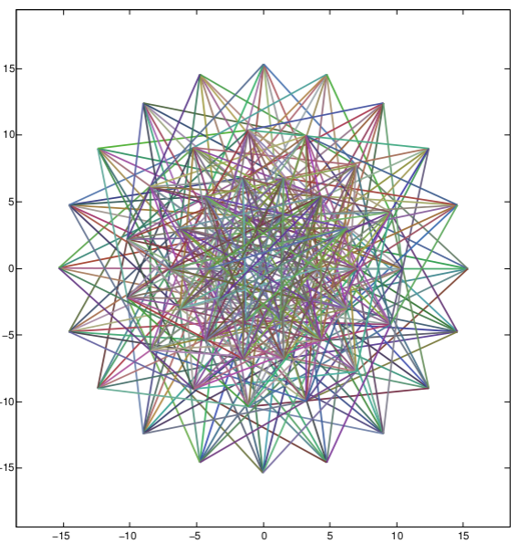
Pattern pairs
Short-distance pairs (512)
Long-distance pairs (870)
Unused pairs (388)

Slide 15
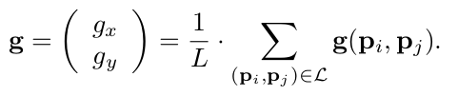
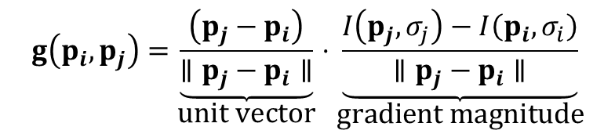
Local gradient/keypoint orientation
$$g\left(p_{i},p_{j}\right)=\underset{\text{unit} \text{vector}}{\underbrace{\frac{\left(p_{j}−p_{i}\right)}{∥p_{j}−p_{i}∥}}}⋅\underset{\text{gradient} \text{magnitude}}{\underbrace{\frac{I\left(p_{j},σ_{j}\right)−I\left(p_{i},σ_{i}\right)}{∥p_{j}−p_{i}∥}}}$$
Comment: Should keypoints with weak gradient magnitude be eliminated?
Strength of gradient between pairs is computed using
Overall keypoint direction vector g is estimated by summing gradients of all pairs in long-distance set.
Notes:
Factored the denominator to make equation more clear

Slide 16
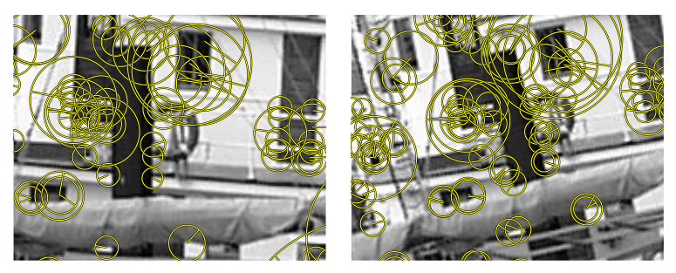
Keypoints with orientation and scale
Notes:
-Radials represent direction
-Radius proportional to scale
-Threshold is set higher for demonstration purposes which means there are less matches

Slide 17
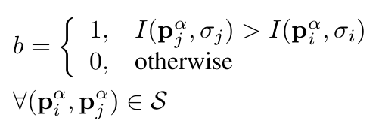
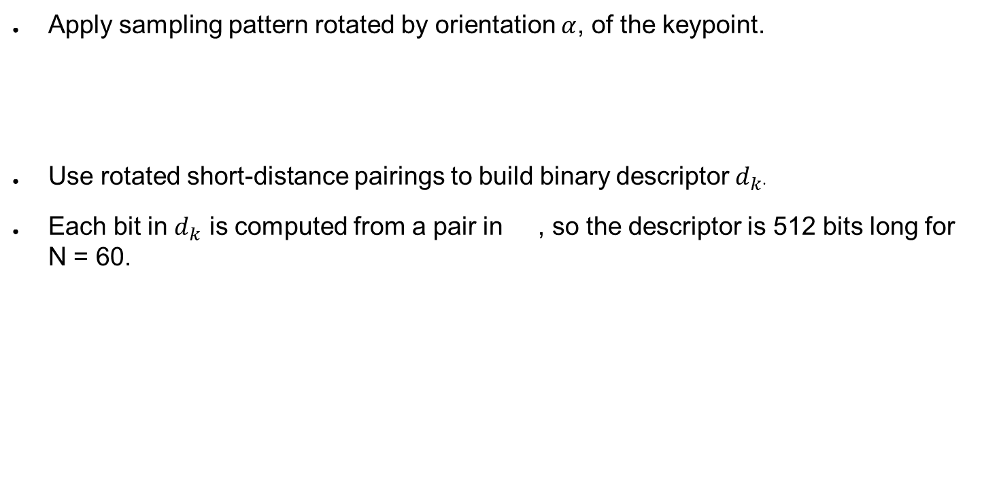
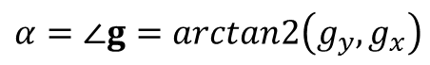
Building descriptor
$$α=∠g=arctan2\left(g_{y},g_{x}\right)$$
Apply sampling pattern rotated by orientation $α$, of the keypoint.
Use rotated short-distance pairings to build binary descriptor $d_{k}$.
Each bit in $d_{k}$ is computed from a pair in , so the descriptor is 512 bits long for N = 60.

Slide 18
Descriptor Properties
Rotation invariant.
Scale invariant.
Notes:
-Rotation invarient because of scaling
-Scale invarient because of scale selection

Slide 19
Descriptor Matching
Hamming distance computed for all pairs between images.
Count matching bits between descriptors.
Efficient computation because this is simply an XOR operation between two 512 bit strings.
Threshold for matching is the number of bits able to be matched.

Slide 20
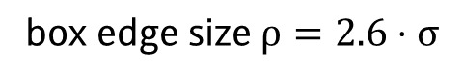
Implementation notes
$$\text{box} \text{edge} \text{size} ρ=2.6⋅σ$$
Use AGAST implementation for computing scores in scale space.
Uses SSE2 and SSSE3 to aid in computing scale space pyramid.
Computing smoothed pixel intensity is actually done using integral images and box filters with floating point boundries, rather than gaussians.
Improved SSE Hamming distance calculator.
Lookup tabled of discrete rotated and scaled BRISK pattern versions. Consumes about 40MB of RAM but allows algorithm to more efficiently retrieve values from the sampling pattern.
Notes:
-Supplemental Streaming SIMD Extensions 3
-Streaming SIMD Extensions 2
-These are intel instruction set which are single instruction multiple data (SIMD) instructions

Slide 21
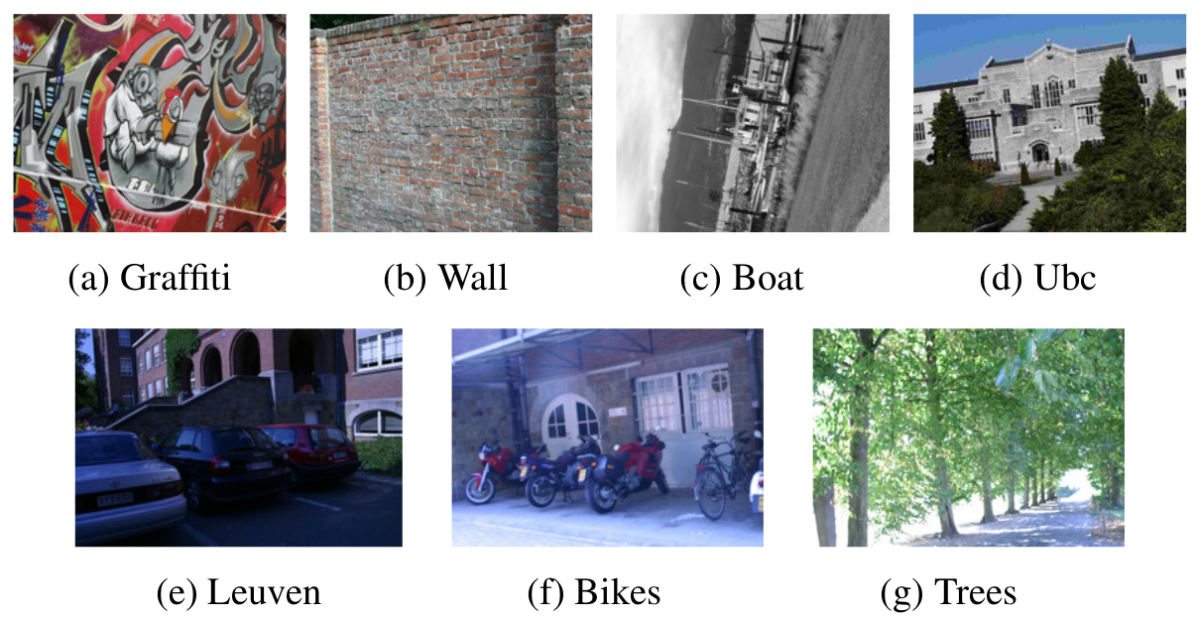
Experiments
7 datasets
All comparisons made against first image in dataset.
Datasets contain ground-truth homography used to determine corresponding key-points.
Considers any pair of keypoints with descriptor distance below a certain threshold a match.

Slide 22
BRISK Repeatability
Repeatability score calculated as ratio between corresponding keypoints and the minimum total number of keypoints visible in both images.
A circle proportional to scale around each keypoint match on one image are transformed onto the other image.
If the circle and ellipse overlap by more than 50% of the union of the shapes, then a match is determined.
Used circle comparable in size to those created by SIFT and SURF.

Slide 23
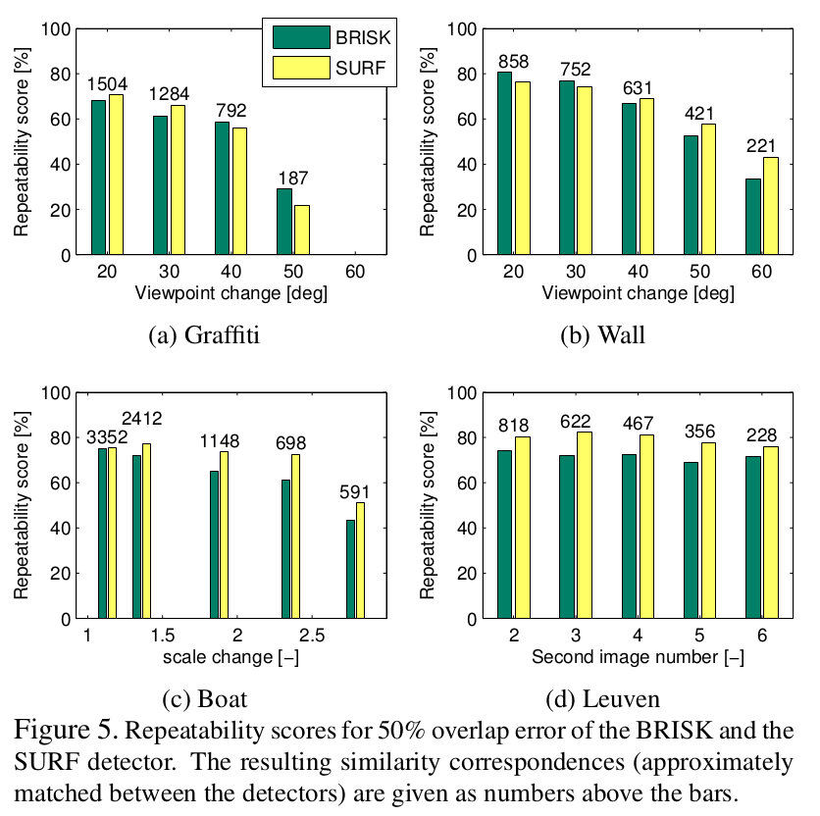
BRISK Repeatability
Compare well to SURF except in transform is not too large.

Slide 24
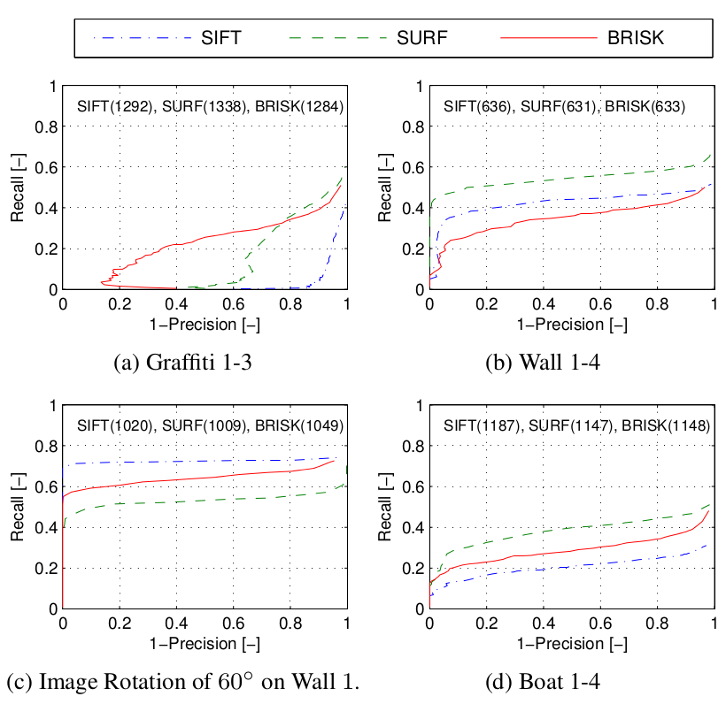
Overall Algorithm Results
Notes:
-A and B: Viewpoint changes
-C: Pure in-plane rotation
-D: Zoom and rotation
-Precision recall curves for BRISK, SURF, SIFT.
-BRISK performs extremely well in the Grafitti image and slightly less well in the other 3 sets.

Slide 25
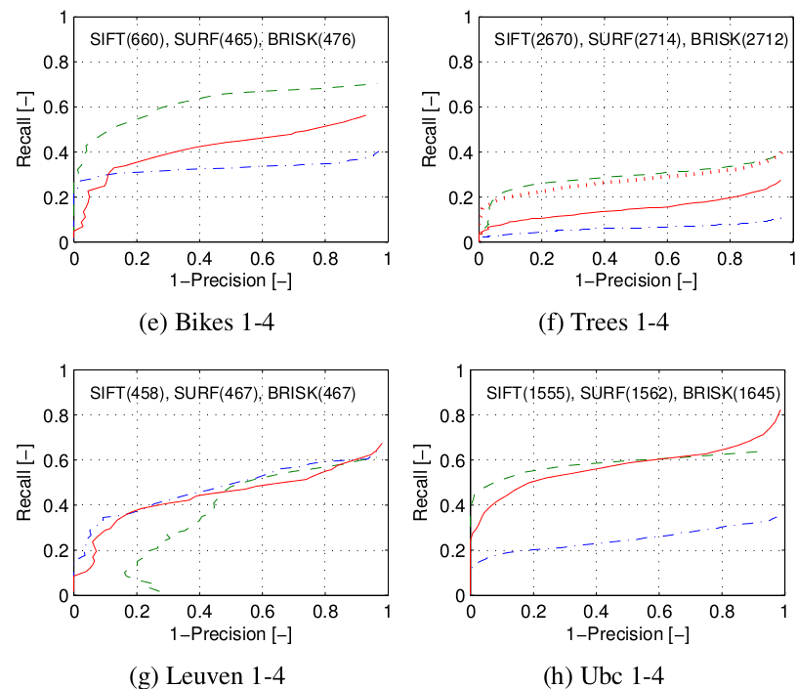
Overall Algorithm Results
Notes:
-E and F: Blur (weakest with blur)
-G: Brightness changes
-H: JPEG Compression
-F: Red dotted line shows performance with BRISK descriptors extracted from SURF regions.
-Precision recall curves for BRISK, SURF, SIFT.
-BRISK does not perform well on the bikes and trees

Slide 26
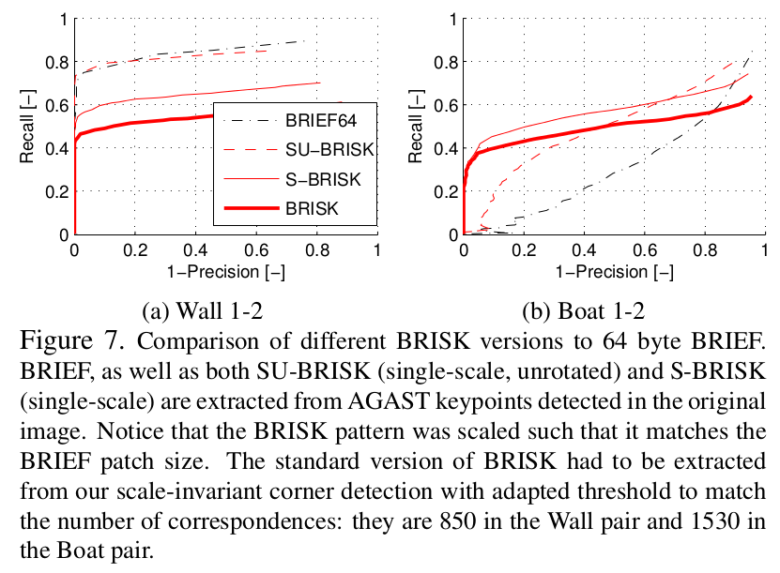
BRISK vs. BREIF
SU-BRISK : Unrotated single scale
S-BRISK : Single scale

Slide 27
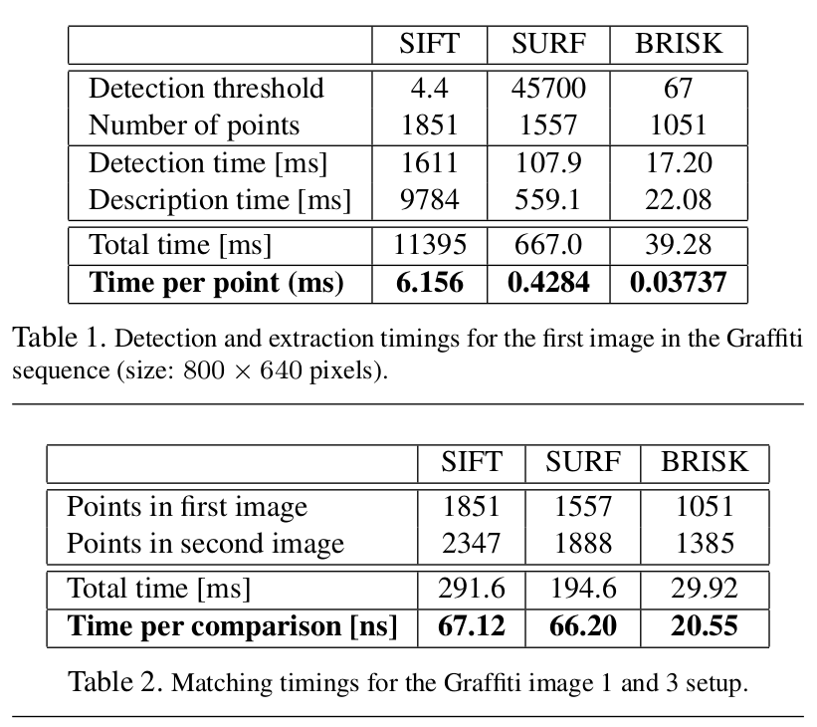
Timing analysis
Easily scalable for faster execution by
reducing number of sampling-points
Examining only one scale.
Omitting pattern rotation step (assuming orientation is always 0)

Slide 28
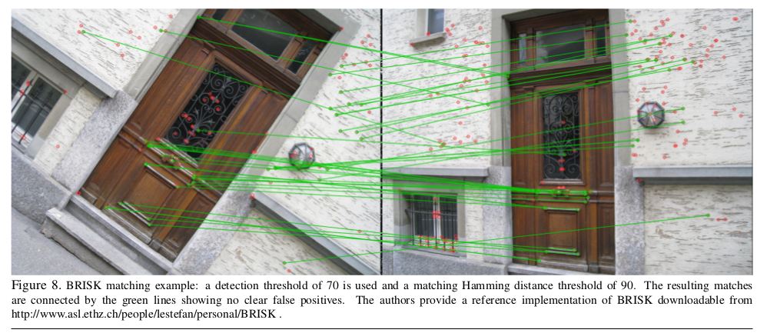
Matching example

Slide 29
Demo Video
http://www.asl.ethz.ch/people/lestefan/personal/BRISK_demo_web.avi

Slide 30
Future work
Explore alternatives to scale-space maxima search of saliency scores to yield higher repeatability while maintaining speed.
Analyze BRISK pattern such that information content and robustness is optimized.

Slide 31
Questions?

